Slide 1



Slide 2
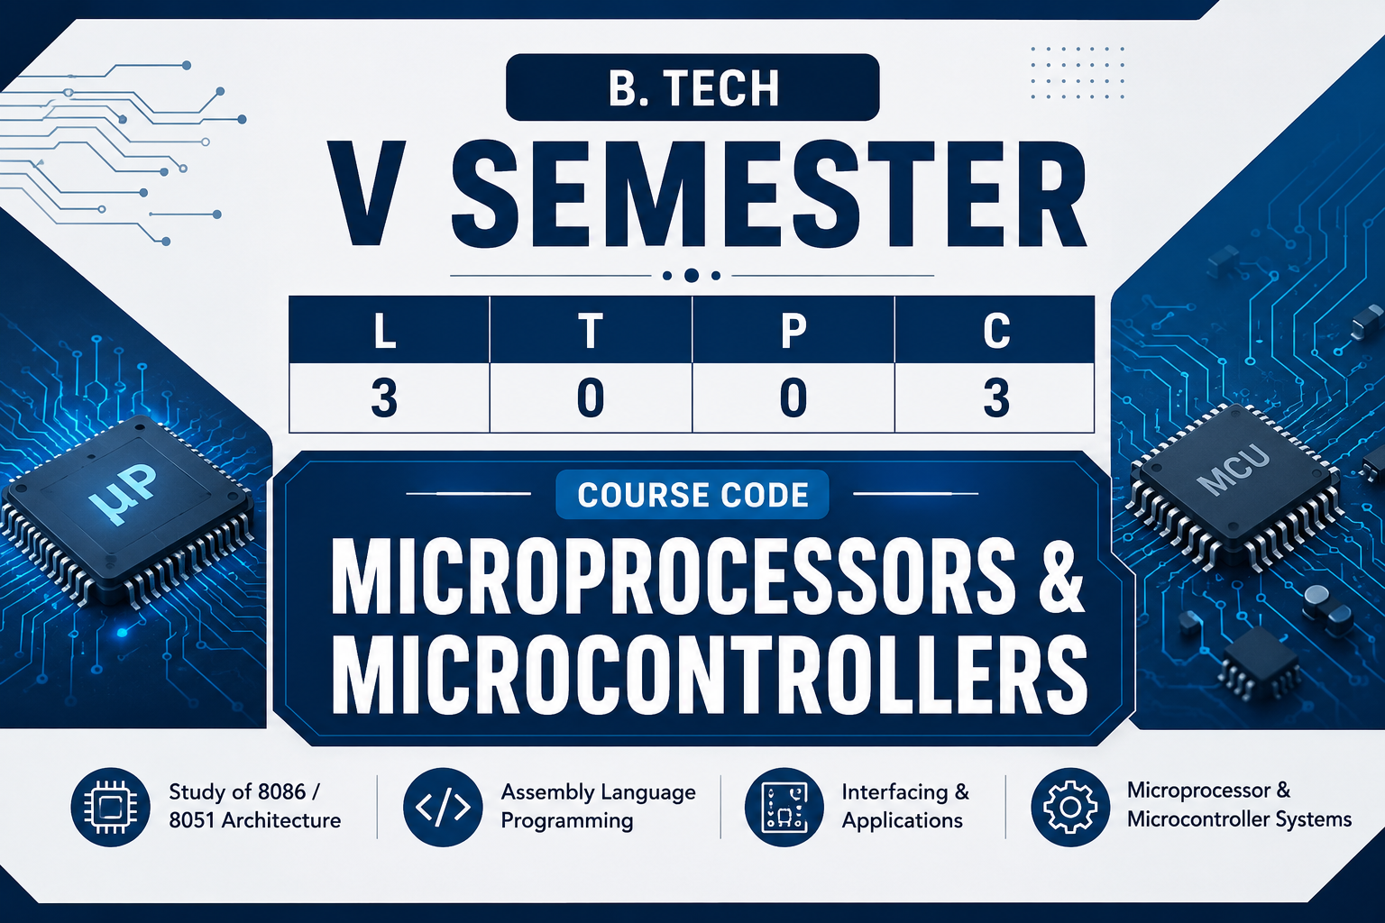

Slide 3
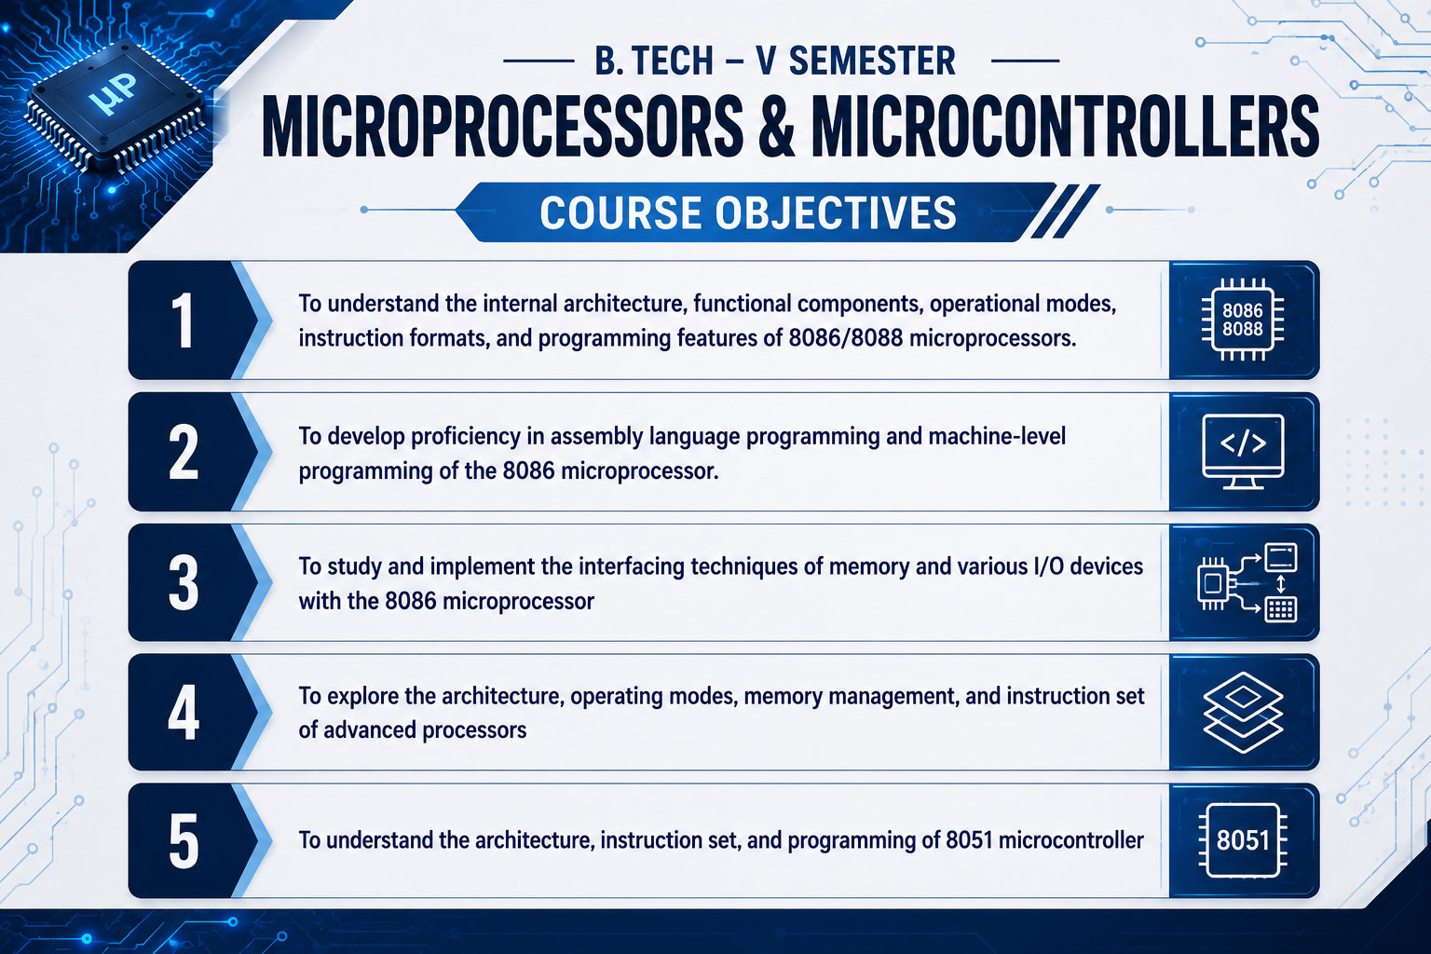

Slide 4

Course Roadmap
Internal Architecture (EU & BIU)
Bus Timings & Machine Cycles
Register Organization & Memory Segmentation
Instruction Formats & Addressing Modes
Pin Diagram & Signal Capabilities
Complete 8086 Instruction Set
Minimum & Maximum Operating Modes
Assembler Directives and Operators
02

Slide 5






Introduction to Intel 8086
The Intel 8086, introduced in 1978, was a breakthrough 16-bit microprocessor designed using HMOS technology. It marked the beginning of the x86 architecture, which continues to dominate the personal computing landscape today.
16-Bit Processing
1MB Memory
Pipelining
16-bit registers and a 16-bit data bus for parallel data movement.
A 20-bit address bus allows addressing of up to 1,048,576 memory locations.
First Intel processor to implement a 6-byte instruction pre-fetch queue.
03

Slide 6


Internal Architecture Overview
The 8086 architecture is uniquely split into two independent functional units that work in parallel. This segregation is the foundation of its pipelining capability.
Bus Interface Unit (BIU)
Execution Unit (EU)
Handles all external bus operations, including fetching instructions, reading/writing operands from memory, and calculating 20-bit physical addresses.
Decodes and executes instructions fetched by the BIU. It contains the ALU, general-purpose registers, and flag register.
04

Slide 7
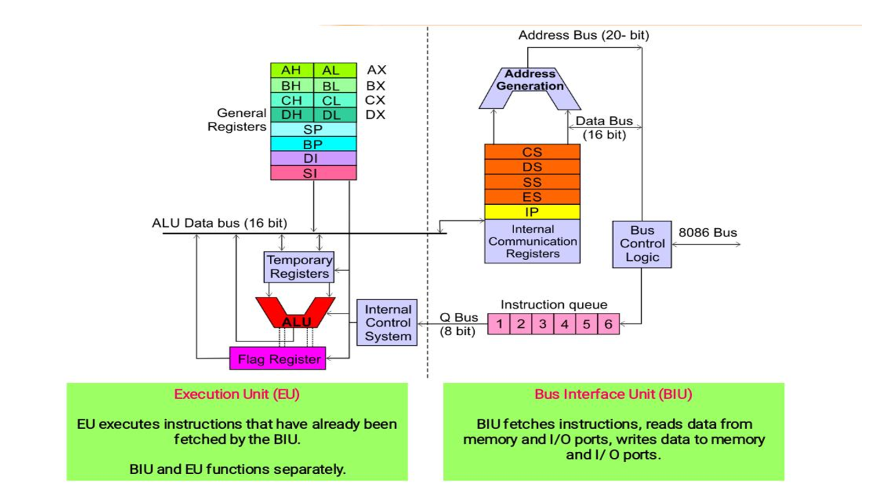

Slide 8
Bus Interface Unit (BIU)
Key Responsibilities
Components
Instruction Fetching: Fetches up to 6 bytes of instruction from memory and stores them in the queue.
Segment Registers (CS, DS, SS, ES)
Instruction Pointer (IP)
Physical Address Calculation: Combines segment registers and offsets to create 20-bit addresses.
Instruction Pre-fetch Queue (6 Bytes)
Address Summer/Adder
Bus Control: Manages signals for memory and I/O reading/writing.
06

Slide 9
Execution Unit (EU)
Key Responsibilities
Components
Instruction Decoding: Interprets machine code from the BIU queue.
Arithmetic Logic Unit (ALU)
General Purpose Registers (AX-DX)
Data Processing: Performed by the 16-bit ALU.
Pointer and Index Registers (SP, BP, SI, DI)
Register Management: Holds operands and results in internal registers.
Status and Control Flags
Control Circuitry
07

Slide 10

Instruction Pipelining
Overlapping Fetch & Execute
Advantages
The BIU fetches instructions from memory and stores them in a 6-byte queue. While the EU is busy executing one instruction, the BIU can fetch the next bytes from memory simultaneously.
Reduces idle time of CPU cycles.
Increased throughput of instruction execution.
Note: Pipelining is flushed during branch/jump instructions as the pre-fetched sequence becomes invalid.
Efficiency: This significantly reduces the time the processor spends waiting for memory accesses, effectively speeding up program execution.
08

Slide 11




General Purpose Registers
8086 contains four 16-bit general purpose registers. Each can be split into two 8-bit registers (High and Low byte).
AX (Accumulator)
BX (Base)
CX (Count)
DX (Data)
Holds the base address for memory operations. Used in indirect addressing.
Default counter for loop instructions, shifts, and rotations.
Holds I/O port addresses and overflow data during 32-bit math.
Used for arithmetic, logical, and I/O operations. Essential for multiplication/division.
09

Slide 12

Pointer and Index Registers
Pointer Registers
Index Registers
SP (Stack Pointer): Points to the top of the stack.
SI (Source Index): Holds the offset of source data in string operations.
BP (Base Pointer): Used to access parameters passed via the stack.
DI (Destination Index): Holds the offset of destination in string operations.
Unlike general purpose registers, these cannot be split into 8-bit components and are primarily used for offset address generation.
10

Slide 13
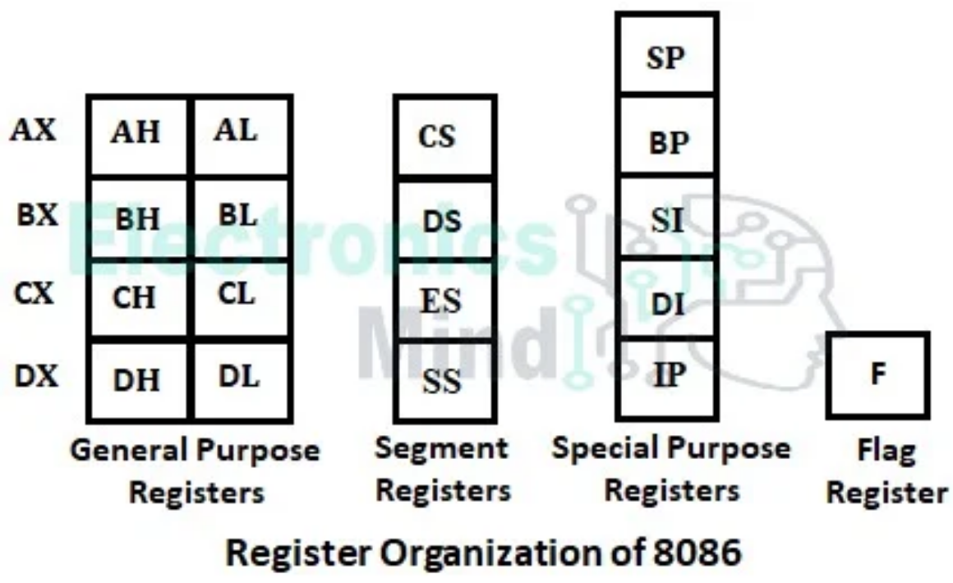
Register Organization Summary
11

Slide 14


Segment Registers
The 8086 uses four 16-bit segment registers to manage its 1MB memory space via segmentation.
CS (Code)
DS (Data)
SS (Stack)
ES (Extra)
Points to the segment where instructions are stored.
Points to the primary data storage segment.
Points to the segment reserved for stack operations.
Additional data segment, typically for string moves.
12

Slide 15

Memory Segmentation Concept
Why Segment?
Memory Bank View
The 8086 has a 20-bit address bus but only 16-bit registers. Segmentation allows the processor to address 1MB of memory by treating it as 16 logical segments of 64KB each.
Memory is organized into two banks: Even Bank (Lower) and Odd Bank (Upper), each 512KB. This enables 16-bit data access in a single bus cycle when word-aligned.
Dynamic relocation of programs.
Code/Data protection between segments.
Efficient utilization of 16-bit pointers.
13

Slide 16

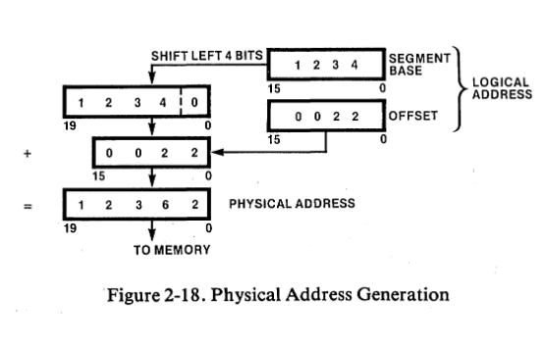


Physical Address Calculation
The Formula
The physical address is generated by shifting the segment register left by 4 bits (multiply by 10H) and adding the 16-bit offset.
Example: If CS = 2000H and IP = 0012H
P.A. = 20000H + 0012H = 20012H
14

Slide 17
Flag Register: Status Flags
The 16-bit Flag register contains 9 active flags. Six are Conditional/Status flags that reflect the result of the previous instruction.
Carry (CF): Set if an unsigned overflow occurs.
Sign (SF): Matches the MSB of the result.
Parity (PF): Set if result has even parity.
Overflow (OF): Set if signed overflow occurs.
Aux Carry (AF): Used for BCD arithmetic.
Zero (ZF): Set if result is zero.
15

Slide 18

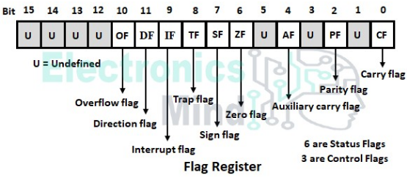
Control Flags & Bit Format
Control Flags
Direction (DF): If 1, string pointers auto-decrement; if 0, they increment.
Interrupt (IF): If 1, maskable interrupts (INTR) are enabled.
Trap (TF): Enables single-step mode for debugging.
16

Slide 19
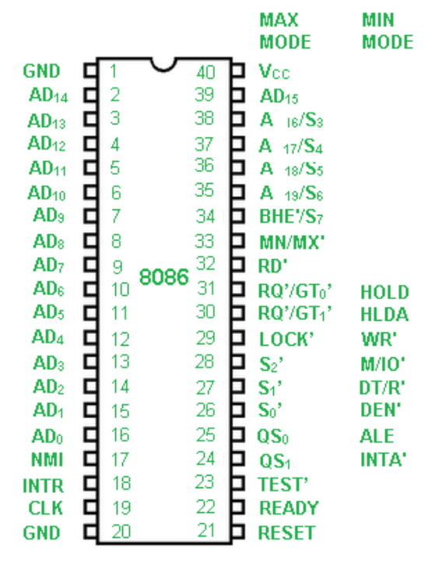
Pin Diagram & Hardware Layout
40-Pin DIP Package
The 8086 is a 40-pin chip that operates on a single +5V supply. It uses multiplexed buses to save pin count.
AD0-AD15: Multiplexed Address and Data bus.
A16/S3-A19/S6: Multiplexed Address and Status lines.
17

Slide 20
Address/Data Multiplexing
Time Multiplexing
BHE (Bus High Enable): Enables the upper memory bank (AD8-AD15).
To reduce the chip's physical size, the lower 16 lines carry the Address (A0-A15) during T1 of a bus cycle and Data (D0-D15) during T2, T3, and T4.
RD / WR: Read or Write control signals.
DT/R: Data Transmit or Receive (controls transceiver direction).
The ALE (Address Latch Enable) signal is used to demultiplex these lines using external latches like the 8282.
18

Slide 21

System Control & Status
READY: Used to synchronize the CPU with slower peripherals. The processor waits if READY is low.
TEST: Used with the WAIT instruction. If low, execution continues; otherwise, the CPU stays idle.
DEN (Data Enable): Enables the transceivers (like 8286) to connect CPU to the data bus.
M/IO: Memory or Input-Output selector. High for memory access, Low for I/O access.
Most control pins change functionality depending on whether the processor is in Minimum Mode or Maximum Mode.
19

Slide 22

Minimum Mode of Operation
Minimum mode is selected by connecting the MN/MX pin to +5V (High). It is used for simple, single-processor systems.
Simpler system design.
Direct Control
Lower cost for small applications.
The 8086 itself generates all control signals like ALE, DEN, DT/R, RD, WR, and INTA.
No support for bus controllers or co-processors.
HOLD and HLDA pins handle DMA requests.
20

Slide 23
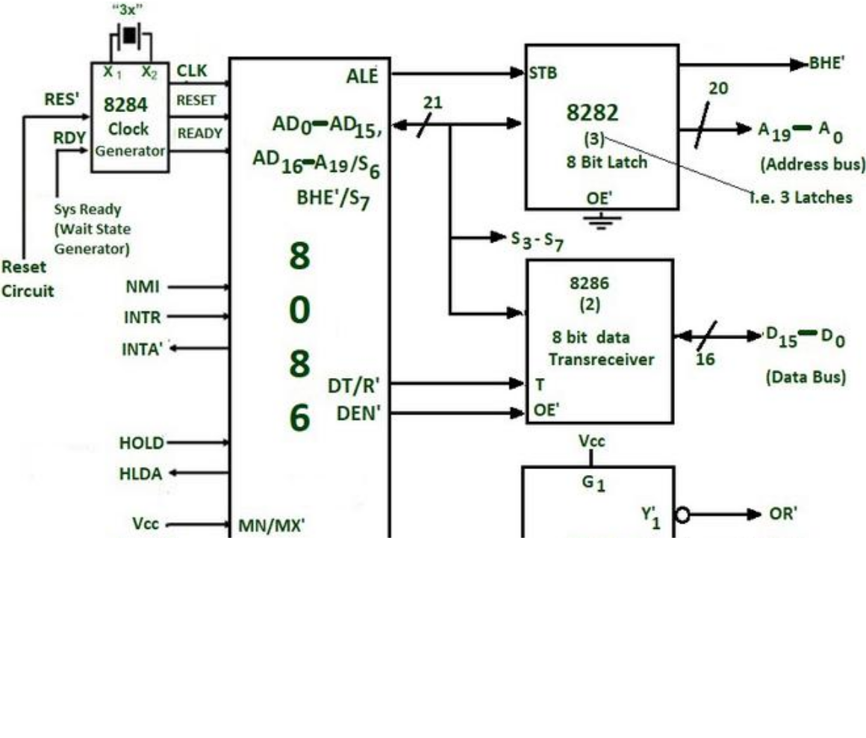
Minimum Mode System Configuration
21

Slide 24
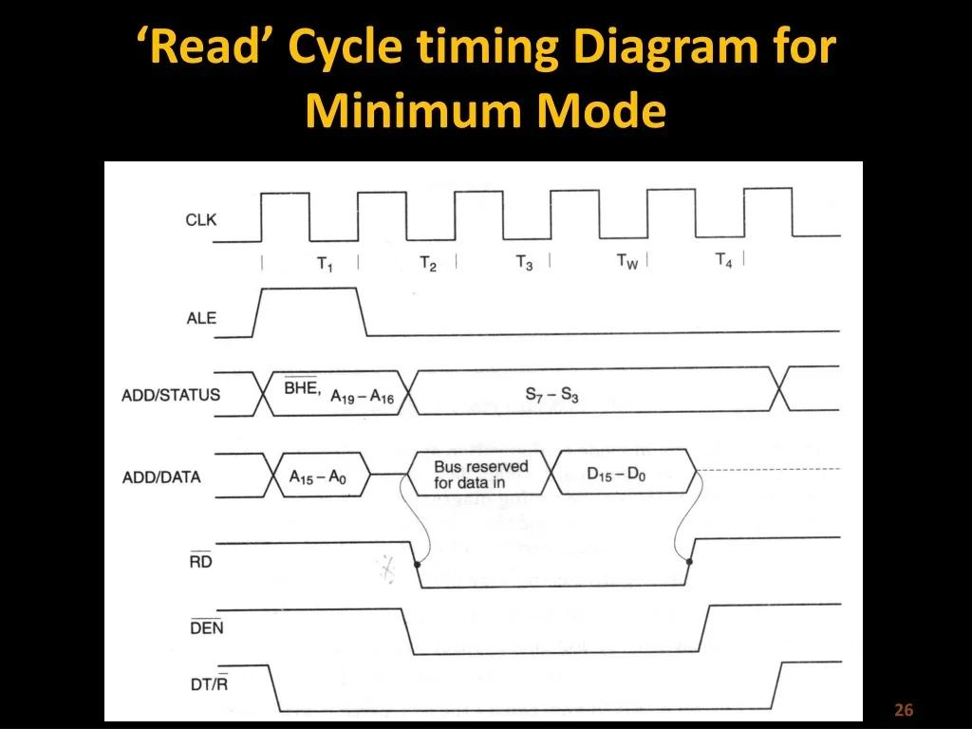

Slide 25
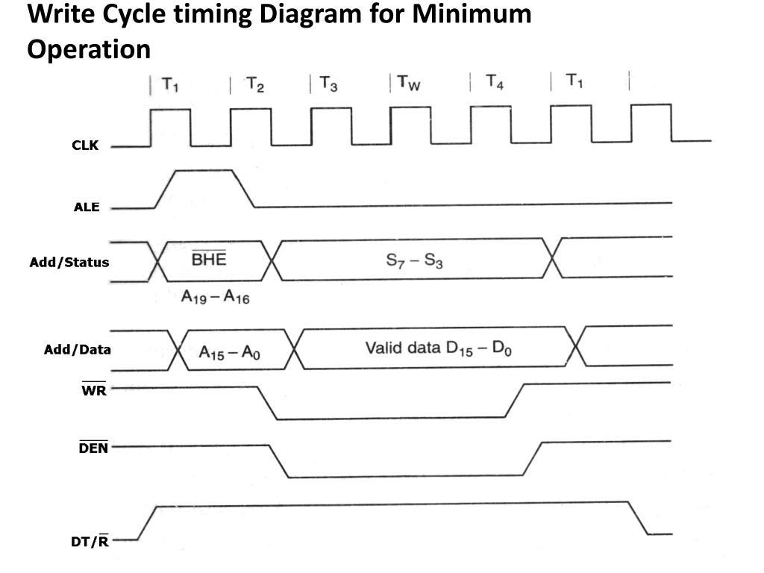

Slide 26
Maximum Mode of Operation
Maximum mode is selected by connecting the MN/MX pin to GND (Low). It is designed for multi-processor environments.
Supports Co-processors (e.g., 8087 Math coprocessor).
Bus Control Logic
Allows multiple masters on the bus.
Standard control signals are replaced by status signals S0, S1, S2. These are decoded by an external 8288 Bus Controller to generate system signals.
Queue status signals (QS0, QS1) allow co-processors to track the instruction queue.
22

Slide 27

8288 Bus Controller Role
S0, S1, S2 (Status): Encoded signals indicating the type of bus cycle (e.g., 010 for Write, 101 for Instruction Fetch).
MRDC / MWTC: Memory Read/Write command signals generated by 8288.
IORC / IOWC: I/O Read/Write command signals.
RQ/GT (Request/Grant): Replaces HOLD/HLDA to allow co-processors to request bus control.
By offloading bus control to the 8288, the 8086 can maintain a simpler pin interface for complex multi-master coordination.
23

Slide 28
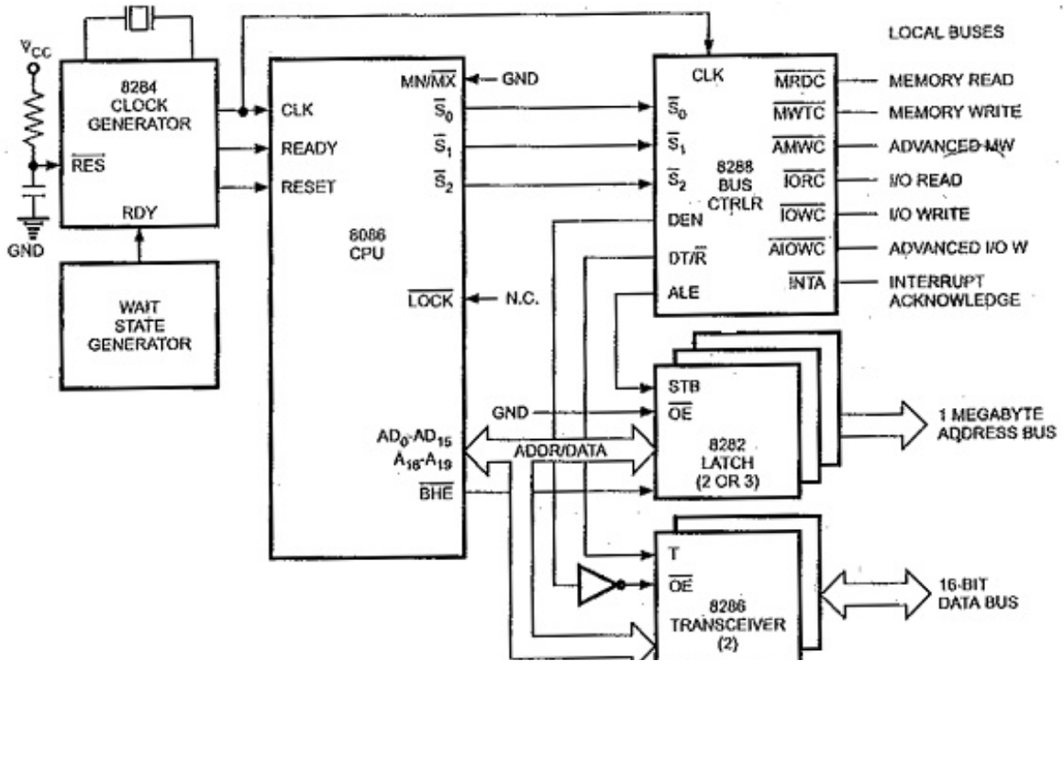
Maximum Mode System Configuration
24

Slide 29
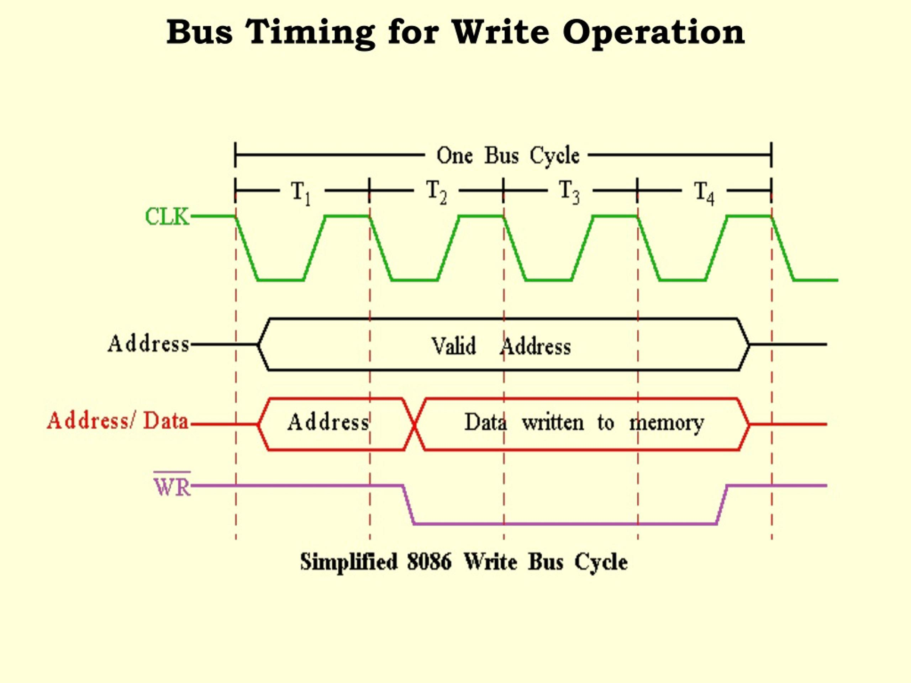

Slide 30
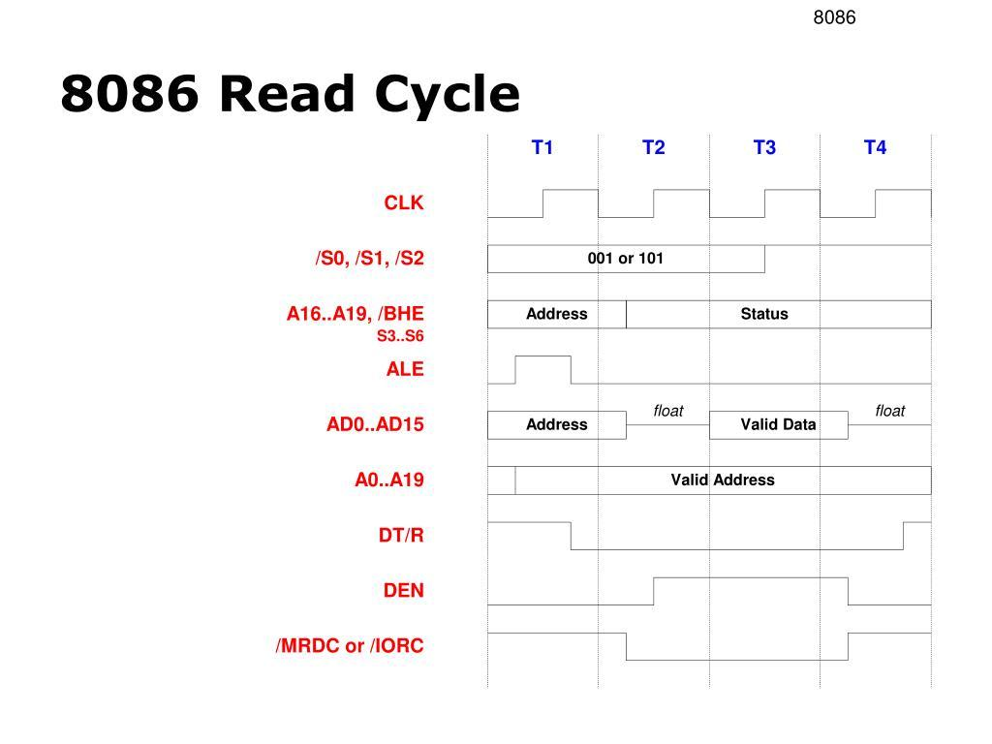

Slide 32

Bus Timings: Machine Cycles
A standard bus cycle in 8086 consists of four clock states (T1, T2, T3, T4). If the memory/device is slow, Wait States (Tw) are inserted between T3 and T4.
Critical Events
State Functions
ALE is active during T1.
T1: Address is output on AD0-AD15.
RD/WR signals are active during T2-T4.
T2: Address is removed; lines change to Status/Data.
READY is sampled during T3.
T3: Data transfer occurs.
T4: Cycle concludes; control signals deactivated.
25

Slide 33
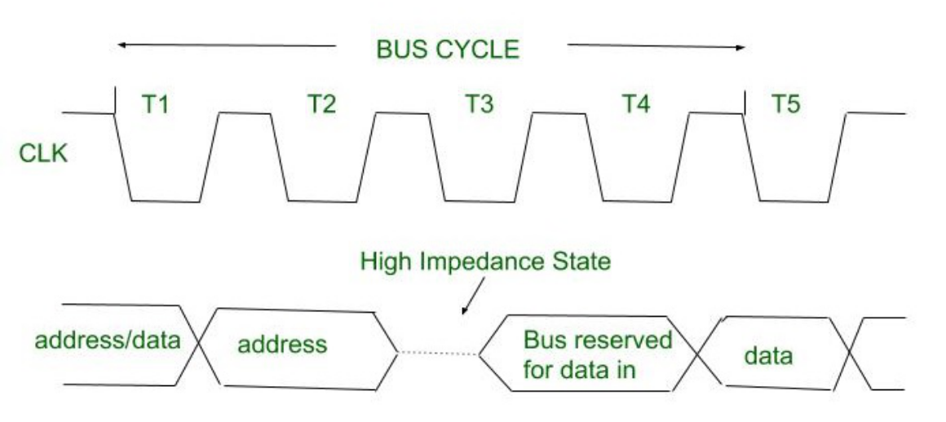
Memory Read/Write Timing Diagrams
26

Slide 34


RESET Activity Sequence
Hard Reset
Initial Register States
Reset must be held high for at least 4 clock cycles. When triggered, the processor clears its internal state and initializes registers.
Flags: Cleared (0000H)
IP: 0000H
CS: FFFFH
DS, SS, ES: 0000H
Queue: Empty
27

Slide 35


Interrupts: NMI & INTR
NMI (Non-Maskable)
INTR (Maskable)
High priority interrupt. Cannot be disabled by software. Typically used for power failure or parity errors. Jumps to vector type 2.
Enabled only if IF flag is 1. sampled during the last cycle of an instruction. Uses INTA sequence to get vector type.
The 8086 supports up to 256 interrupt types via an Interrupt Vector Table (IVT) located at memory addresses 00000H to 003FFH.
28

Slide 36

Machine Language Formats
8086 instructions range from 1 to 6 bytes. Most follow a standard multi-field structure.
Byte 1: Opcode (6 bits), D bit (Direction), W bit (Word/Byte).
Byte 2: MOD field (Mode), REG field (Register), R/M field (Reg/Memory).
Byte 3-4: Optional Displacement (8 or 16 bit).
Byte 5-6: Optional Immediate Data.
D bit: 1 = REG is destination; 0 = REG is source.
W bit: 1 = 16-bit operation; 0 = 8-bit operation.
29

Slide 37
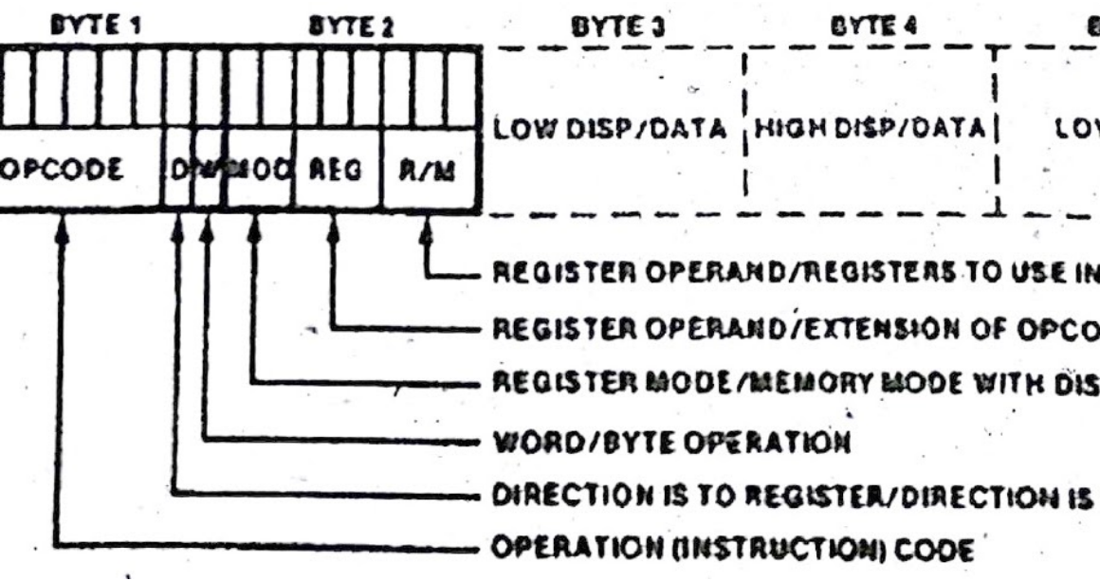
The MOD-REG-R/M Fields
30

Slide 38
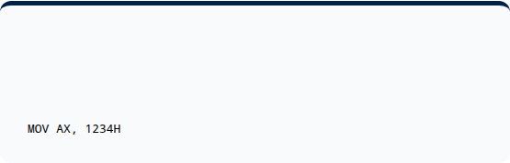
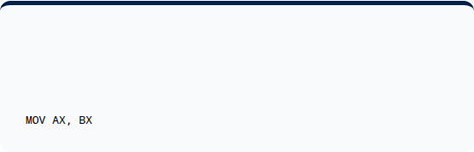
Immediate & Register Modes
Immediate Addressing
Register Addressing
The operand is part of the instruction itself.
Both operands are in registers. No memory access needed.
Register addressing is the fastest mode as it doesn't involve the external system bus for data transfer.
31

Slide 39
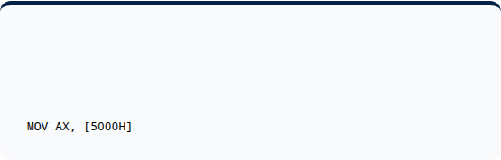

Direct & Indirect Addressing
Direct Addressing
Register Indirect
16-bit offset is provided directly in the instruction.
The offset is stored in BX, SI, or DI. Pointer-like behavior.
Memory operands are always assumed to be in the Data Segment (DS) unless a segment override prefix is used.
32

Slide 40

Based & Indexed Addressing
Based Addressing: Uses BX or BP registers. Offset = Base + Displacement.
MOV AX, [BX + 5]
Indexed Addressing: Uses SI or DI registers. Offset = Index + Displacement.
MOV AX, [SI + 10]
Based Indexed: Combines both. Offset = Base + Index + Displacement.
MOV AX, [BX + SI + 2]
Note: BP uses SS by default; BX/SI/DI use DS by default.
33

Slide 41
Data Transfer Instructions
Instruction | Function | Example
MOV | Move byte or word to destination. | MOV AX, BX
PUSH / POP | Push/Pop word from stack. | PUSH AX
IN / OUT | Input/Output from/to port. | IN AL, 08H
LEA | Load Effective Address to register. | LEA BX, [SI+2]
XCHG | Exchange source and destination. | XCHG AX, DX
35

Slide 42

Arithmetic Instructions
Basic Operations
Specialized Math
ADD / SUB: Sum or difference.
ADC / SBB: Add/Sub with Carry.
INC / DEC: Increment/Decrement.
DAA / DAS: Decimal adjust (BCD).
MUL / DIV: Unsigned mult/div.
AAA / AAS: ASCII adjust.
Arithmetic instructions automatically update status flags (CF, ZF, SF, etc.) based on the result.
36

Slide 43



Logical & Bit Manipulation
Logical
Shifts
Rotates
AND, OR, XOR, NOT, TEST (logical AND for flags only).
SHL (Shift Left), SHR (Shift Right), SAR (Arithmetic Shift Right).
ROL, ROR (Rotate), RCL, RCR (Rotate through Carry).
Logical operations are bitwise and typically clear the Carry and Overflow flags.
37

Slide 44

Control Transfer Instructions
Unconditional
Conditional
JMP: Absolute or relative jump.
CALL / RET: Subroutine management.
JZ / JNZ: Jump if zero/not zero.
JC / JNC: Jump if carry.
LOOP: Auto-decrements CX.
Control transfer instructions modify the Instruction Pointer (IP) and sometimes the Code Segment (CS).
38

Slide 45
String Manipulation
String instructions allow the processor to work on large blocks of memory efficiently, using SI and DI registers.
MOVSB / MOVSW: Move string byte/word.
CMPS: Compare string operands.
SCAS: Scan string for specific value in AL/AX.
LODS / STOS: Load/Store string into accumulator.
REP Prefix: Used with CX to repeat the operation until CX=0. Example: REP MOVSB copies a whole block of memory.
39

Slide 46
Assembler Directives: Data
Directives are instructions to the assembler, not the CPU. Data definition directives initialize memory variables.
Directive | Meaning | Example
DB | Define Byte (8-bit) | VALUE1 DB 55H
DW | Define Word (16-bit) | ARR DW 1000H
DD | Define Double Word (32-bit) | VAR DD 12345678H
DUP | Duplicate operator | BUFF DB 10 DUP(0)
EQU | Equate (Constants) | PORT EQU 08H
40

Slide 47


Assembler Directives: Control
Segment Control
Code Organization
SEGMENT / ENDS: Defines logical memory segments.
ASSUME: Assigns segment registers to logical segments.
PROC / ENDP: Defines procedures (subroutines).
ORG: Sets the location counter (origin).
END: Marks the end of source file.
41

Slide 48
Assembler Operators
OFFSET: Returns the 16-bit displacement of a variable. MOV BX, OFFSET DATA1
SEG: Returns the segment address of a label. MOV AX, SEG MY_CODE
PTR: Overrides the default size of an operand. MOV BYTE PTR [SI], 10
TYPE: Returns the size (1 for DB, 2 for DW, etc.).
LENGTH: Returns the number of elements in an array.
42

Slide 49

Summary & Conclusion
The Intel 8086 remains a fundamental subject for understanding computer architecture. Its parallel functional units, segmented memory model, and flexible instruction set laid the groundwork for decades of microprocessor evolution.
Thank you for your time. Questions are welcome.
43

Slide 50






Image Sources
https://www.eeeguide.com/wp-content/uploads/2018/08/8086-Internal-Architecture.jpg
Source: www.eeeguide.com
https://electronicsmind.com/wp-content/uploads/2021/12/registers-in-8086-microprocessor-1419822061.jpeg.webp
Source: electronicsmind.com
https://static.righto.com/images/8086-ad-pins/physical-address-generation.jpg
Source: www.righto.com
https://electronicsmind.com/wp-content/uploads/2021/12/flag-registers-of-8086-microprocessor-152235522.jpeg
Source: electronicsmind.com
https://media.geeksforgeeks.org/wp-content/uploads/20221114154946/pindiagramof808611.png
Source: www.geeksforgeeks.org
https://media.geeksforgeeks.org/wp-content/uploads/20210527131324/Minmode-660x560.jpg
Source: www.geeksforgeeks.org

Slide 51




Image Sources
https://www.eeeguide.com/wp-content/uploads/2018/08/Maximum-Mode-Configuration-of-8086-2.jpg
Source: www.eeeguide.com
https://media.geeksforgeeks.org/wp-content/uploads/20200618092027/Untitleddrawing7.jpg
Source: www.geeksforgeeks.org
https://blogger.googleusercontent.com/img/b/R29vZ2xl/AVvXsEi_bxRPI8uJq1qsaBu5Dr0Oie2KKeSxVLYr_72caAofBKFd6ACKZ9RmgRM4xH_j4hL-GZqbBI8kPHSwUFJchRZ696dBosLj1gjYWRQagseuV6_2pQPops4XSaOSTS83_bKaMCaCHmmfnYw/w1200-h630-p-k-no-nu/Screenshot_1.jpg
Source: mmrcse.blogspot.com
https://imgv2-2-f.scribdassets.com/img/document/940816001/298x396/747f741430/1761854090?v=1
Source: www.scribd.com

Slide 52


Slide 53


